Slide 1
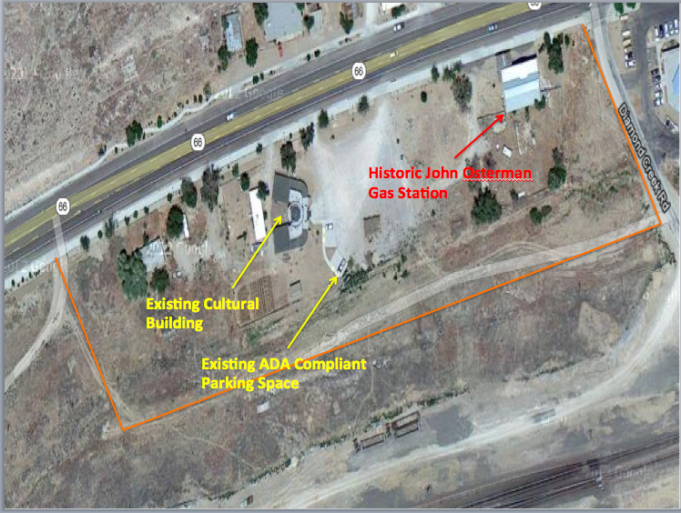

Proposed Hualapai Museum Site Design
APEX Engineering
Ian Braun
Andrew Halley
Jorge Hernandez
Mohamad Haikal Bin Maamor

Slide 2
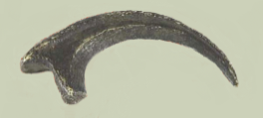
Presentation Overview
Project Understanding- Slide 3
Scope of Services- Slide 8
Projected Timeline- Slide 14
Proposed Budget- Slide 15

Slide 3
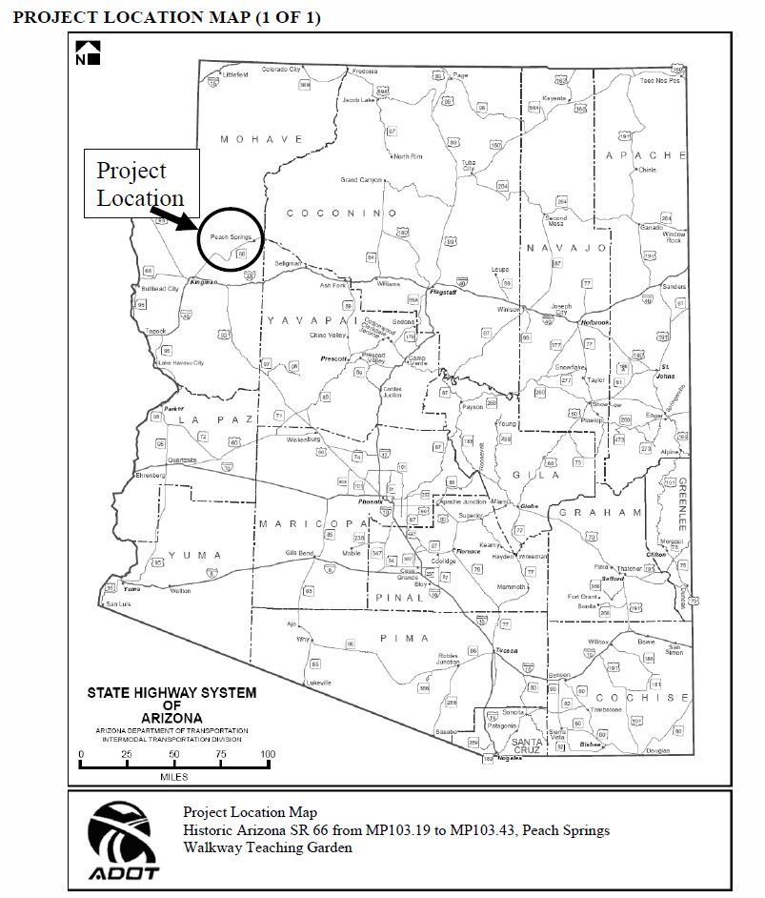
Project Understanding
Background Information
Stakeholders
Existing Site Conditions
Design Challenges

Slide 4
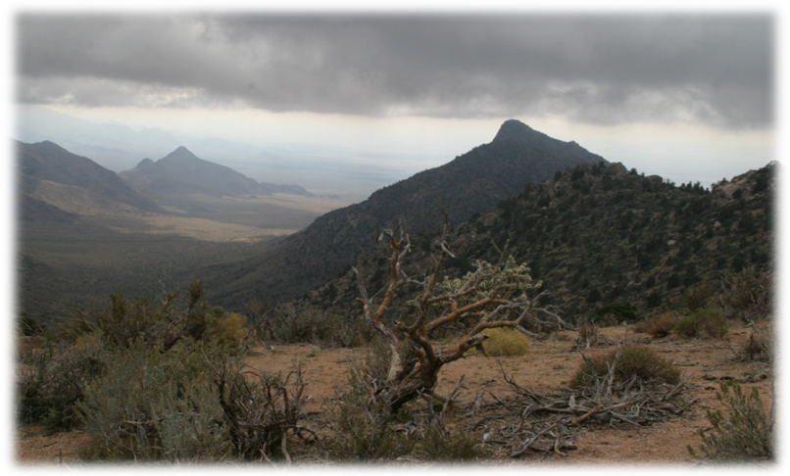
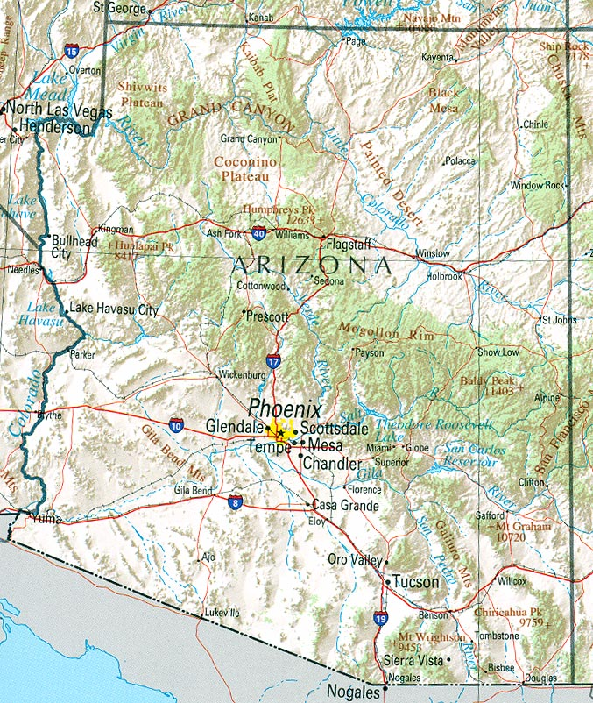

Background informATION
The Hualapai Reservation
(nearly a million acres) located in Northwest Arizona, on Historic Route 66, 54 miles northeast from Kingman, was established by Executive Order in 1883, and is home to the Hwal’bay, or People of the Tall Pines.
Capital: Peach Springs AZ

Slide 5
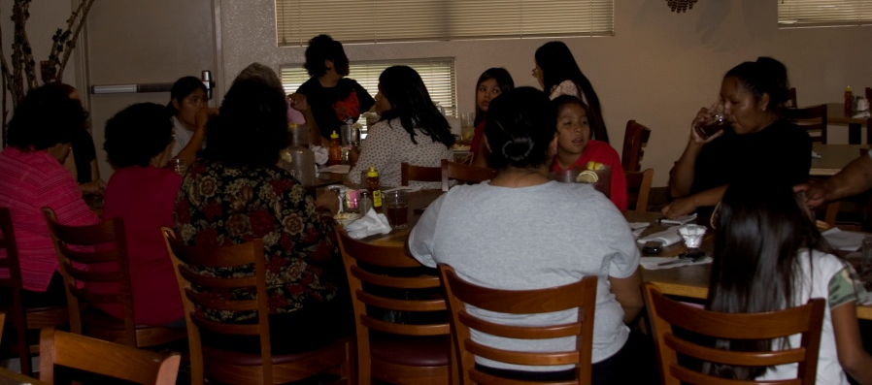
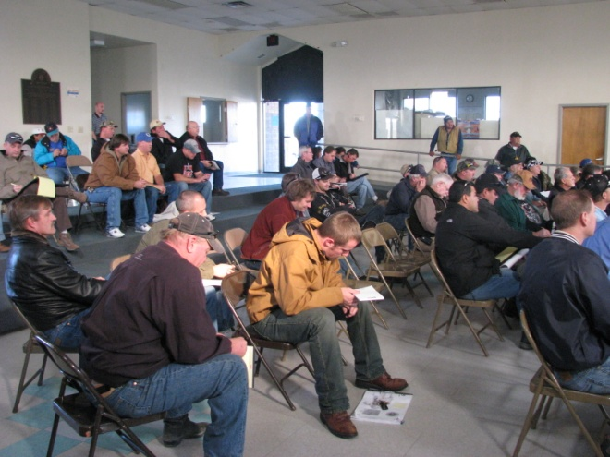
Stakeholders
Tribal Administration and Hualapai Nation
Bureau of Indian Affairs
Other Donors both Government and Private
Dawn Hubbs, Hualapai Program Manager

Slide 6
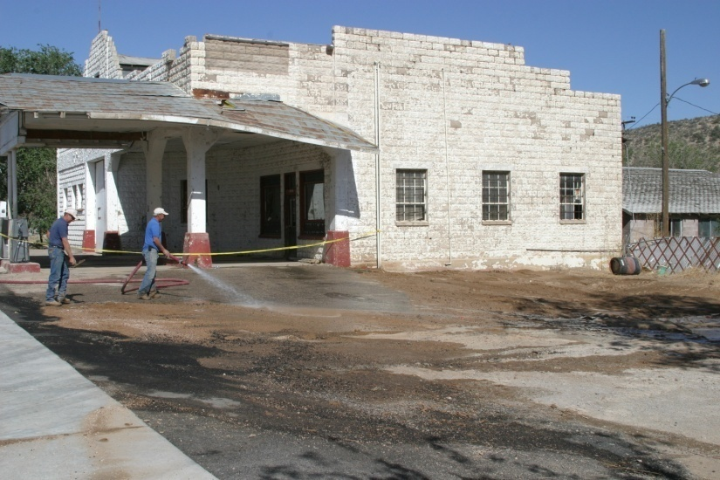
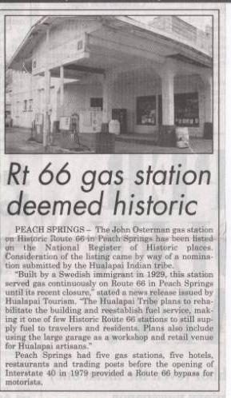
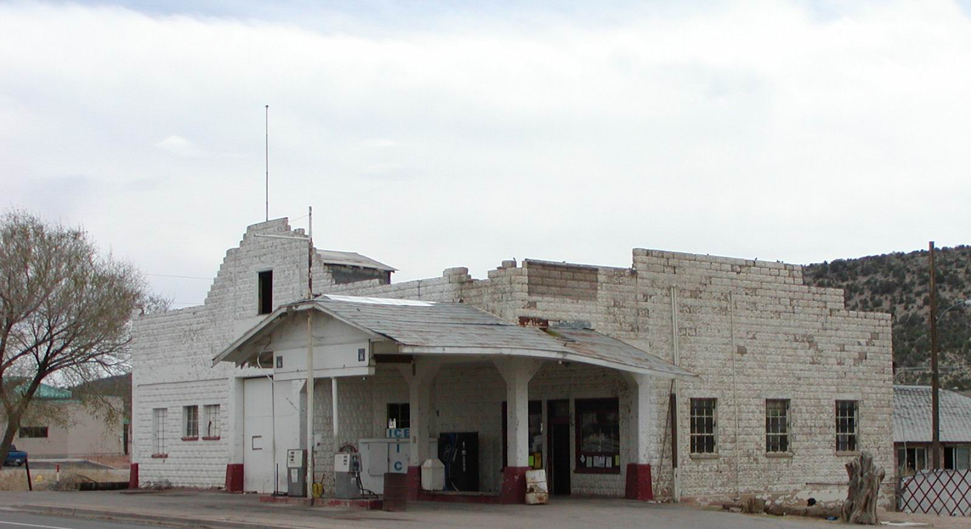
Existing Site Conditions
Total site 7.5 acres subdivided into 7 lots
Historic buildings
Hualapai cultural center
Un-paved parking lot for the Hualapai Cultural Center

Slide 7
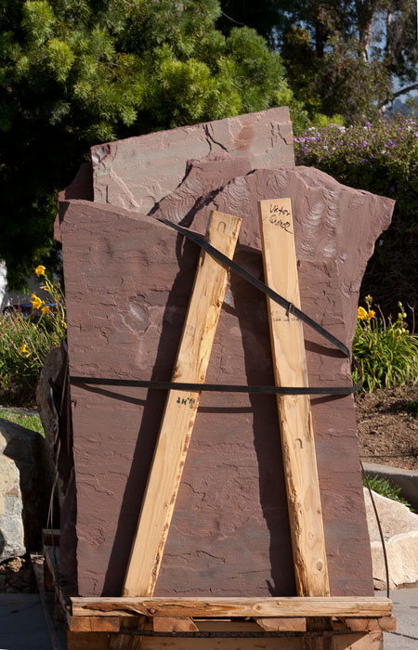
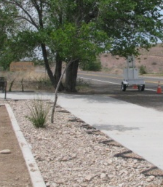
Design Challenges
Presence of a railroad easement adjacent to the proposed site
Storm water wash runs through property
Preserve local trees and plants present on the site
Use of building materials native to the area
Pre-existing building foundations and abandoned reinforced concrete sewer lines
All building entrances must face East

Slide 8
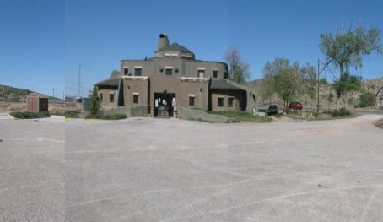
Scope of Services overview
Project Management
Land Surveying
Fill/Grading Plan
Storm Water Drainage Design
Sanitary Sewer Systems
Municipal Water Supply
Parking Facility Design

Slide 9
Project management
Field Visits
Workshops with Client- Tribal Government and Community
General Manager:
Andrew Halley
Field Surveyor:
Ian Braun
Fill/ Grading Plan:
Mohamad Haikal Bin Maamor
Sidewalk/Paving :
Jorge Hernandez

Slide 10
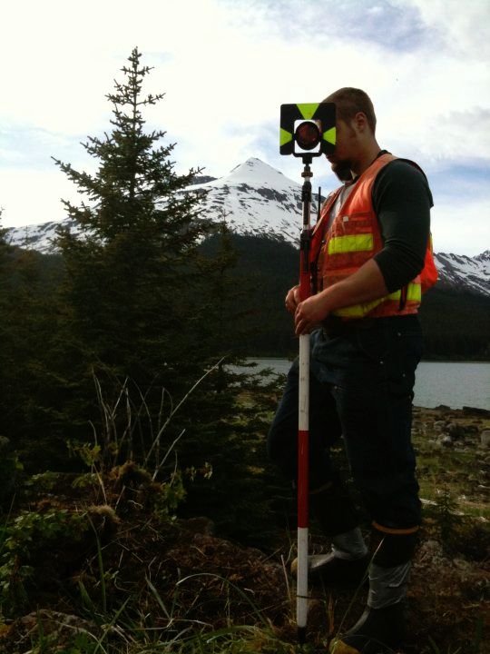
Land Surveying
First step for civil site design
Used to create a detailed topographic map
Necessary task for all aspects of civil site design
Establish control points from ADOT highway monuments
Confirm work with past surveyors
Deliverables: Contour Map, Proposed Fill/Grading Plan, Control Point Data Table

Slide 11
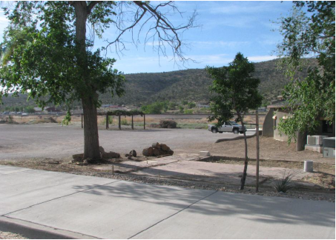
Storm Water drainage
The current condition of the 7.5 acre parcel is bare earth
A large combined parking facility is proposed
The proposed paved parking facility and museum structure will alter the existing hydrology of the property
Using the topographic map, the team will analyze new drainage issues
Sizing hydraulic structures such a drop inlets and culverts will be considered
Outflow will be fed into adjacent permeable grassland
Potential for an oil water separator
Deliverables: Runoff Analysis, Hydraulic Structure Design Specifications

Slide 12
Sanitary Sewer/Municipal water supply
Peach Springs, AZ has citywide water distribution and wastewater removal
The proposed sanitary sewer should be designed and constructed in compliance with the Arizona Administrative Code
Blue stake will be contacted and existing utility lines will be shown on the contour map
Municipal water/sanitary sewer connection will be coordinated with public works
Deliverables: Lines Located on Contour Map, Proposed Schematic for Acceptable Connection Location

Slide 13
Parking facility design
The proposed Hualapai museum will bring increased traffic to the area.
A traffic count will be conducted on the surrounding intersection.
Utilizing a modeling software the parking facility can be sized accordingly.
Using the volumes from the analysis, and complying to the ADA guide lines the parking lot will be designed.
Walkways and sidewalks will be designed as deemed necessary by the stakeholders
Deliverables: PetraPRO report, Synchro Printout, AutoCAD Drawing of Parking Facility

Slide 14
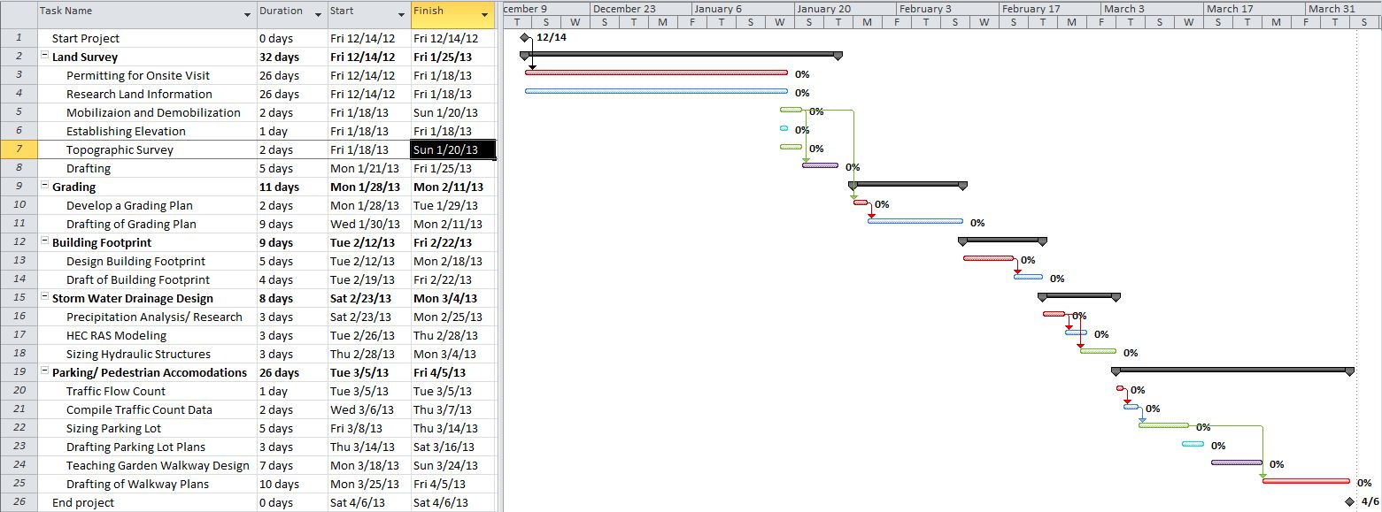
Project Design Timeline

Slide 15
Proposed Budget
Task Name | Position | Amount | Cost per Hour | Duration (hrs) | Total
Land Survey
Permitting for Onsite Visit | N/A | 0 | $0.00 | 500 | $0.00
Research Land Information | Sr. Engineer | 1 | $150.00 | 16 | $2,400.00
Mobilization and Demobilization | Engineer | 4 | $75.00 | 6 | $1,800.00
Establishing Elevation | Crew man | 2 | $45.00 | 2 | $180.00
Topographic Survey | Crew man | 2 | $45.00 | 10 | $900.00
Drafting | Sr. Engineer | 1 | $150.00 | 12 | $1,800.00
Grading
Develop a Grading Plan | Engineer | 2 | $75.00 | 8 | $1,200.00
Drafting of Grading Plan | Engineer | 2 | $75.00 | 8 | $1,200.00
Building Footprint
Design Building Footprint | Sr. Engineer | 2 | $150.00 | 16 | $4,800.00
Draft of Building Footprint | Sr. Engineer | 1 | $150.00 | 8 | $1,200.00

Slide 16
Proposed Budget continued
Task Name | Position | Amount | Cost per Hour | Duration (hrs) | Total
Storm Water Drainage Design
Precipitation Analysis/ Research | Sr. Engineer | 2 | $150.00 | 5 | $1,500.00
HEC RAS Modeling | Sr. Engineer | 1 | $150.00 | 5 | $750.00
Sizing Hydraulic Structures | Sr. Engineer | 2 | $150.00 | 8 | $2,400.00
Parking/ Pedestrian Accommodations
Traffic Flow Count | Engineer | 2 | $75.00 | 8 | $1,200.00
Compile Traffic Count Data | Engineer | 1 | $75.00 | 4 | $300.00
Sizing Parking Lot | Engineer | 2 | $75.00 | 8 | $1,200.00
Drafting Parking Lot Plans | Engineer | 1 | $75.00 | 6 | $450.00
Teaching Garden Walkway Design | Sr. Engineer | 2 | $150.00 | 8 | $2,400.00
Drafting of Walkway Plans | Sr. Engineer | 1 | $150.00 | 6 | $900.00
 |  |  |  | Total | $26,580.00

Slide 17

Questions?

